Slide 1
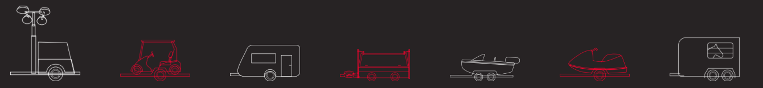

WULI X RITA SOLUTIONS
IFB399: CAPSTONE PROJECT (PHASE 2)
Robert Hume | Issak Madden | Teagan Cliff | Amit Saini
N9830561 | N9160850 | N9829628 | N9650911
Researcher | Project Manager & Developer | Team Leader & Developer | Developer
Notes:
Quick Introduction
10 seconds
Issak
Hi everyone, I’m Issak, this is Robert, Teagan and Amit and we’re RITA Solutions and here’s what we’ve done in 9 months in 5 minutes

Slide 2
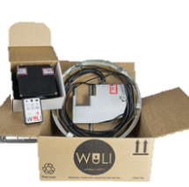
PRODUCT & DOMAIN
WULI is a compact security device fit to the wheel of a towed vehicle
The device…
locks and unlocks the trailer wheel
models equipped with an accelerometer sound an alarm upon detecting movement
In Phase 1 we planned to:
Create an application to replace the RF remote in generation 2 (will be manufactured with Bluetooth instead)
Develop a distributor portal with existing e-commerce website
Provide a report with GPS research on service providers for future generations of WULI
Notes:
Product: 10 seconds
Robert
Project planning: 15 seconds
Robert
Wuli is a remote control locking mechanism equipped to the inside of the wheel of a non-motorised vehicle. Controlled over radio frequency technology, via a remote users are able to send lock and unlock commands which trigger a motorized locking pin to engage and disengage. Additionally users can disable an alarm activated by detected movement from their remote.
In phase 1 we planned to create an application operating over Bluetooth for the next generation, develop a distributor portal as an add on to their existing website created by third-party developers, and provide a proposal on the value of adding GPS tracking services to future generations.

Slide 3




TRACKING
Android Application
The Android application has been developed; this connects and controls via Bluetooth Low Energy (BLE)
Sends and logs lock, unlock and disable alarm signals upon user interaction
GPS Proposal Report
A GPS research report has been created for the client to assess the value of adding GPS to WULI
Website Report
Due to accessibility delays from third-party developers, the distributor portal was changed from a development to consulting project
A technical report has been created on a proposed solution to deliver requirements for a future development team
Notes:
Tracking: 30 seconds
Teagan
Over the semester the team has managed to complete the three required tasks given by the clients.
The application is prepared to pair with Bluetooth equipped versions of the Wuli device.
The GPS proposal was created to allow the client to assess the value of implementing the GPS to the WULI device.
The distributor portal had to be altered from a development project to a consulting project. This was due to time constraints from a third-party. The website has now been changed to a technical report.

Slide 4
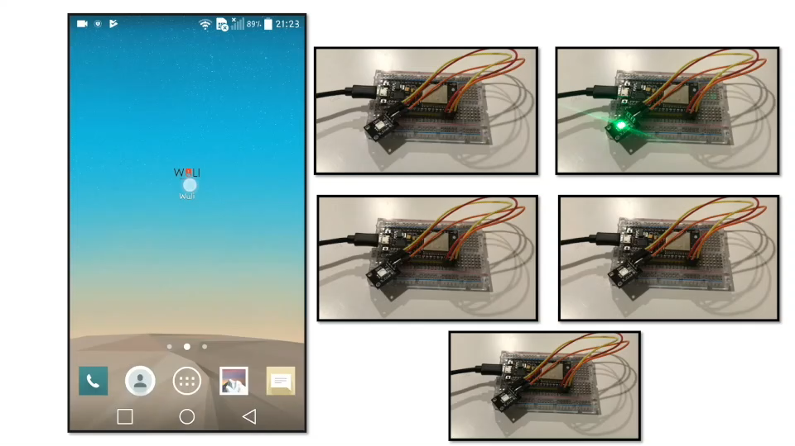
ARTEFACT: APP
Notes:
Amit: Talk about application functionalities ~70 seconds
Edit:
Moving onto the Wuli Android application. The Wuli app serves a couple of purposes. One of them being able to locate the Wuli device and provide exact co-ordinates for tracking. Home screen displays this to the user for quick monitoring.
Moving onto controls, another important functionality of the app. Signals are sent via Bluetooth technology. Locking will require the user to enter the pin to lock the device, as will unlocking. The application invalidates incorrect and invalid length passwords in it’s first layer of authentication.
Then comes the change password feature in which a user can override their old password with a new one.
Forgot password requires a user to enter their secret unique Wuli ID which resets their password to 1234(?)
The disable alarm functionality allows a user to disable the alarm when activated if they have the alarm equipped model.
The location section will serve advance functionality through GPS tracking; allowing the locking the device if lost and routing the signal to the device’s location. This has been implemented in a mocked fashion and will be further developed when a GPS provider is chosen.
And here comes the logs section where all records of communication between the app and Wuli is stored and can be cleared by the user.
***
Thanks **. All right moving on to cool stuff, Wuli android application. Wuli app is going to serve couple of purposes one of them being able to locate wuli device and provide its exact co-ordinates for tracking. Home screen presents on the go location of the wuli device for quick monitoring. Moving on to controls, another important functionality of the app is to connect with Wuli device via bluetooth low energy aka BLE module. It hits 2 targets at once. One being 100 times less power consumption then ordinary bluetooth device, inturn not affecting wuli’s battery much and secure connection as not all of the standard bluetooth apps can connect with it. Locking will require you to enter the pin to unlock the device Whereas Unlocking will help you to unlock the device. Interesting part is wuli will filter out all of the invalid length of password in it’s first layer of authentication. Then comes the change password in which you can change your old password with new one. Forgot password will require you to punch in the unique Wuli Id which is unique to every device and it will reset the password to default 123. Disable alarm functionality helps in that time when an alarm is activated , so as to disable alarm. Location section will serve up the advance functionality regarding tracking of device, locking the device if lost and generating rout to the device where it is right now. This part of section depends upon what device is yo be used for gps and depends upon the client if they want to have the device being installed in Wuli. And here comes the logs section where all of the records of communication between Wuli device is kept and can be cleared easily with clear logs button if needed. Now handing over to Isaak
***
Issak: Talk about implementation in future, i.e. BLE (mention battery friendly), Bluetooth module and firmware replacing RF module. Application coding for lock, unlock, disable alarm functions in place with tested Bluetooth connectivity, will just need to be tied together when a Bluetooth module is selected and manufactured in product. ~50
With some limitations surrounding the project due to Wuli not yet equipped with Bluetooth, there were limitations surrounding testing. The application establishes connectivity to the Wuli with a Bluetooth Low Energy service running in the app’s background. Lock, unlock and disable alarm signals have been programmed and tested with a microcontroller and LED’s to ensure connectivity. The Wuli as is communicates over radio frequency with the C coded firmware of the RF module. Similarly, once Wuli management and PCB designers have established the Bluetooth module for future models, signals received from the application will receive application commands. Additionally GPS services have been researched and proposed to management for future generations which may be equipped with GPS. An activity has been setup within the application developed with the Google Map API for ease of implementation once a service provider has been selected for manufacturing.
90-120 seconds

Slide 5
ARTEFACT: PROPOSAL REPORTS
GPS Service Report
The current version of WULI does not include GPS but it may be added in the future
A report was complete addressing the value of adding GPS to future generations of WULI
GPS services will integrate existing technologies to show the user their device’s live location
Space is provided in the Android application for GPS tracking if it is to be included
Website
Wholesale Suite Plugin Bundle is the recommended plugin with easy customisation
The report is used for possible future capstone group or freelancing
The report is delivering the requirements that the clients agreed on
Notes:
Robert: Talk about GPS service report (30 seconds)
Existing versions of Wuli have no tracking capabilities, and Wuli management have discussed the interest of possibly adding GPS tracking services to the device in future generations. A GPS proposal has been created providing technical and payment information for delivery to our client with artefacts for assessment of if this is an effective investment for the business. Activities have been created within the Android application with Google Maps API’s for ease of implementation should future models be equipped with this technology.
Teagan: Talk about website (30 seconds)
The website distributor portal had to be altered to a technical report due to third-party timing issues. The technical report states what is the best plugins to use on the WordPress site that match what Mark and Cath were requesting. This also includes the prices, customisation and ease of use for each plugin. The report will allow for simplified planning and development for a future development team to complete.

Slide 6



QUALITY METRICS
Design
Application design instills Gestalt’s Design Principles of proximity, similarity and symmetry
Additionally considered Fitt’s Law and thumb space in design
Code Quality
Testing
Tested on 2 different Android devices and 5 different specification emulators
0 compilation warnings or errors, 0 runtime errors experienced in testing
Notes:
(20 seconds) Issak: Design theory principles have been implemented in the aesthetic design of our application to ensure a high quality of practicality and aesthetic. Gestalt’s design principles meant ensuring close proximity of relating buttons and UI components, a consistent theme in terms of font styles and design icons. Fitt’s Law and thumb space allowed for ensuring appropriate sizing and positioning of interface elements and confirmation of implementation in user feedback. Developed in Android Studio UI elements are consistent with the operating system creating a user friendly result.
(20 seconds) Amit: Code quality & Testing
The exported application has been tested on 2 different physical devices and 5 different emulators running a variation of specifications. The app build and generation in its IDE does not flag any warnings or errors, and no runtime errors have been experienced in testing after thorough troubleshooting and resolution of any hurdles in development.

Slide 7
CREDITS
Team Contributions
Special thanks to Mark and Cath, WULI founders for being a pleasure to work with over the year
Huge thank-you to Wayne for all of your guidance this semester!
 | Robert | Issak | Teagan | Amit
GPS Research Report
Website Portal Research
Website Portal Report
Android Application Development
Application Testing
Documentation
Meeting Attendance
Notes:
(15 seconds) Conclusion…
As you can see all students have contributed to different elements of the project.
Special thanks to Mark and Cath the founders of Wuli for being a pleasure to work with over the year and a huge thank-you to Wayne our tutor for all of his guidance over the year.

